Slide 1
Data Structures Workshop
Day 22

Slide 2
Workshop Outline
Binary Search Trees (Continued)
Tree Traversal Implementations
BST Method Implementations
search()
getHeight()
getDepth()
BST Practice Problems

Slide 3
Tree Traversals
As mentioned in the previous workshop, we have 3 different sorts of Tree Traversals to use:
Inorder Traversal
L P R
Preorder Traversal
P L R
Postorder Traversal
L R P

Slide 4
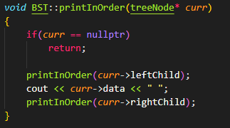
Inorder Implementation

Slide 5
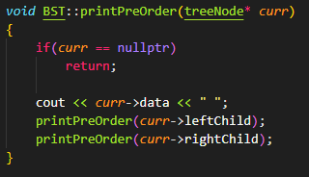
Preorder Implementation

Slide 6
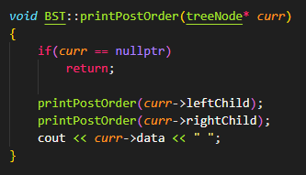
Postorder Implementation

Slide 7
Where is the Print?
The only difference here is where we print our node!
So just remember where the print happens in each traversal, and knowing how to implement them is then super easy.

Slide 8
BST Deletion Implementation
Remember that in our node deletion implementation, we have 3 cases to deal with:
Deleting a node with no child nodes
Deleting a node with 1 child node
Deleting a node with 2 child nodes

Slide 9
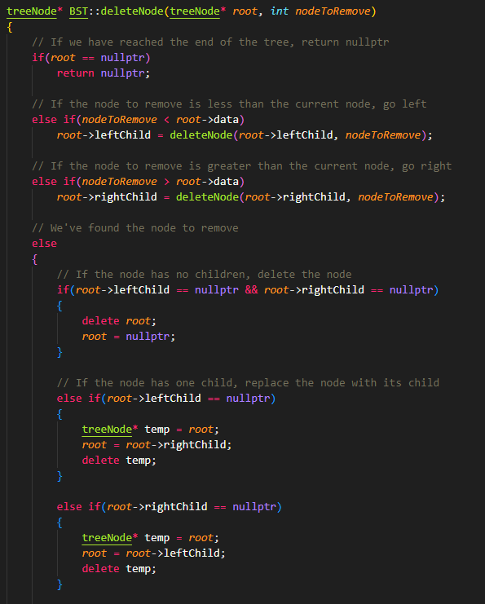
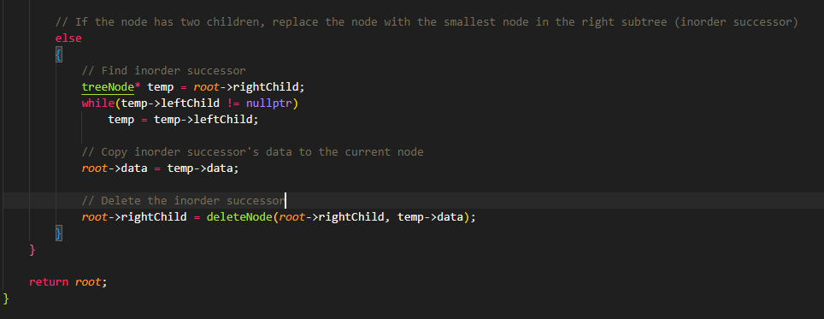
deleteNode() Implementation

Slide 10
search() Function
Implement a function that searches for a given value in a BST. Return “true” if the value exists in the BST and “false” if it doesn’t.
bool search(node* root){
}

Slide 11
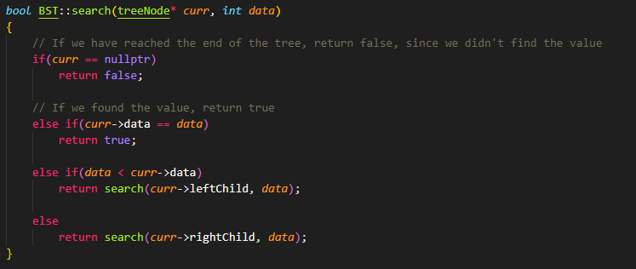
Solution

Slide 12
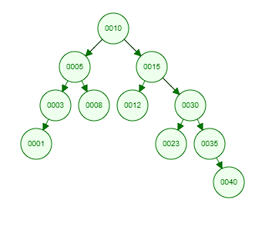
getHeight()
Write a function that returns the height of a given node from its lowest child.
Assume that the height of a node starts at 0 and that height = -1 implies there are no nodes.
int getHeight(node* sourceNode){
}
Examples: getHeight(10) = 4
getHeight(5) = 2
getHeight(1) = 0
getHeight(15) = 3

Slide 13
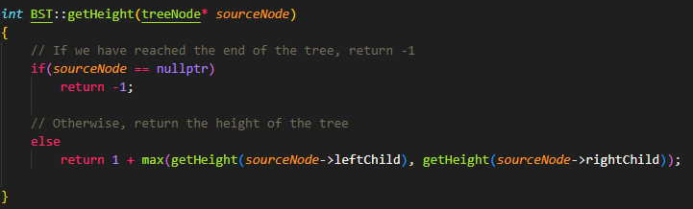
Solution

Slide 14
getDepth()
Write a function that returns the depth (distance from the root node) of a given node starting at 0. Return -1 if the node doesn’t exist in the BST.
int getDepth(node* curr, int targetNode, int depth){
}
Examples:
getDepth(10) = 0
getDepth(5) = 1
getDepth(35) = 3
getDepth(12) = 2
getDepth(9) = -1

Slide 15
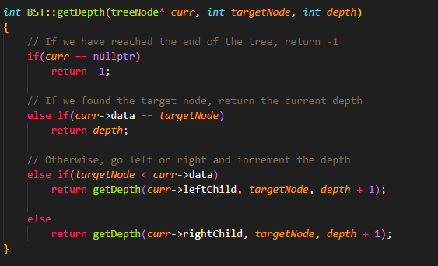
Solution

Slide 16
BST Problems for Practice !!

Slide 17
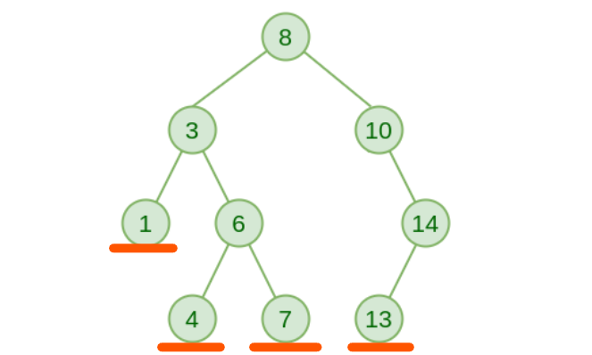
printLeaves()
Implement a function that prints all the leaf node of the BST. (leaf node a parent node without children)

Slide 18
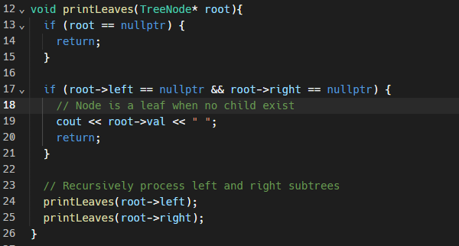
Solution

Slide 19
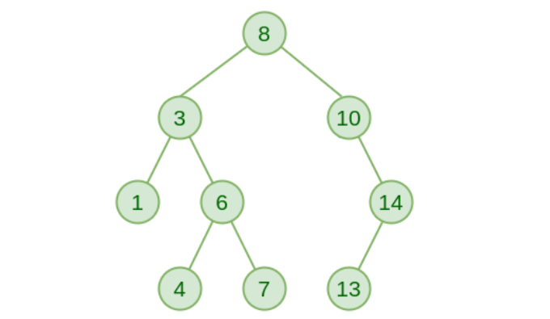
Convert BST to a Sorted Array
Given a BST, implement a function that sort the tree to an Sorted Array.
1 | 3 | 4 | 6 | 7 | 8 | 10 | 13 | 14

Slide 20
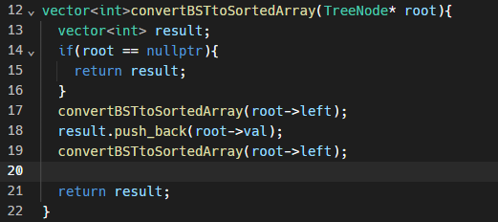
Solution

Slide 21
Find Kth smallest in BST
Given K, find the Kth smallest node in BST.
If k=2, find 2nd smallest element in BST.
return 3
int findKthSmallest(TreeNode* root, int& k)

Slide 22
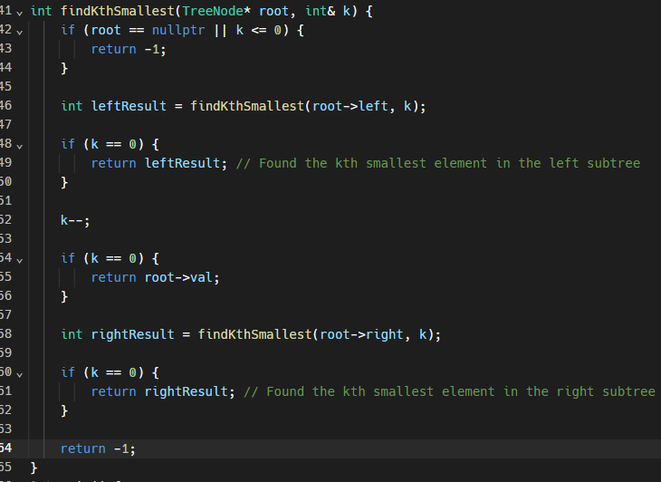
Solution

Slide 23
Find Kth largest in BST
Given K, find the Kth largest node in BST.
If k=2, find 2nd largest element in BST.
return 13
int findKthLargest(TreeNode* root, int& k)

Slide 24
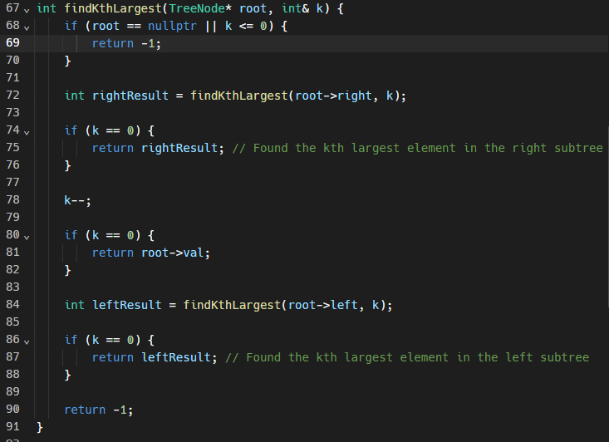
Solution

